Slide 1
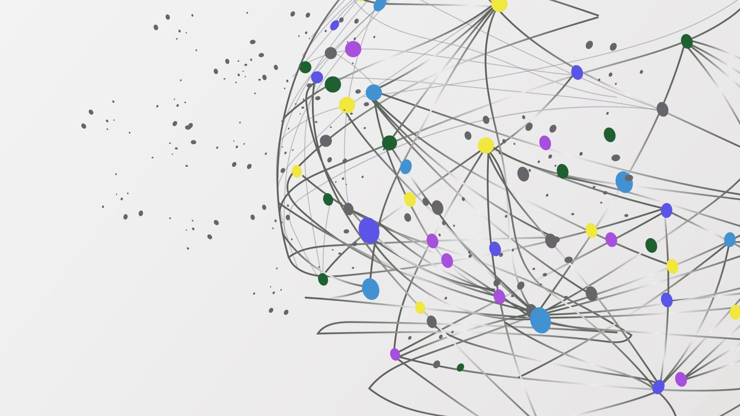
FlexType EMG Keyboard
Half-Byte Solutions
Julia Johnson
Giancarlos Hernandez Mendoza
Jalen Tottress
Kejon IverY

Slide 2
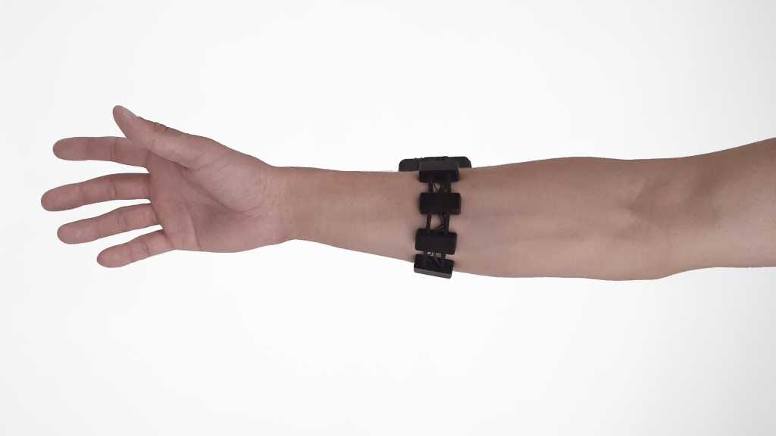
Project Overview
Market Problems
Our Solution
People with neurological disabilities have difficulty typing on standard keyboards
Voice-to-text is not private, and often does not work for people in loud areas, noise-restricted areas, or for people with diseases like Parkinson's
Other technologies, like eye-tracking devices, are often expensive and difficult to carry around
A lightweight, wearable electromyography (EMG) armband worn around the arm
The EMG picks up signals from muscle movements and sends them to our PCB
The PCB uses a custom made CNN model to determine which gesture is being made
Gestures are converted into letter groups, then passed into the existing FlexType Word Prediction model to type in the predicted word

Slide 3

Recap of Milestone #1
Software
Hardware
Had to Update How We Take In Gesture Data
Initially took in gestures at 1 second intervals
Updated to take in at 7 second periods, with 2 seconds of rest, 3 seconds of gesture, 2 seconds of rest
Struggled to get many volunteers
Gesture Prediction Model at 60% Accuracy
Did not achieve goal of at least ~75% accuracy
Was not able to isolate best/ worst gestures
Completed the PCB designs
Created two PCBs, a control board and an electrode board
Electrode board gathers the EMG signals and sends them to the control board
Control board processes the sent signals to be used in our models
Created the BOM list for purchasing the components
Created a BOM list for 2 control board and 5 electrode boards. Which came out to be 63$ and 121$ respectively.
Started drafting up our enclosures for the PCBs

Slide 4

Milestone #2 Goals & Objectives
Software
Hardware
Gesture Model Recognizes at Least 4 Gestures
Build CNN model to recognize each gesture
Identify which gestures are easy to recognize and which cause problems
Achieve at least 90% accuracy on at least 4 gestures
Refine Model Training Set
Gather EMG data from at least 18 more people
Determine final 8 gestures
Begin gathering training data with PCB
Combine Hardware Components
PCB/ Components Arrive
PCB is built and functional
Print 3D casing for PCB
Combine PCB with 3D casing
Word Prediction Model Recognizes Gestures as Letters
Determine how gesture model will output predictions
Determine how gestures will be input into FlexType Model
Determine which gestures correspond to each letter group/ command

Slide 5

Our Database
Current Database
Next Steps
Taking data can now be lower priority
Can lower the number of desired volunteers/ samples from 45 (end goal) to ~15
Now focusing on live data gathering and interpretation with PCB
Data from 9 people with old method
Data from 9 people with new method
Current model currently uses data from the new method
12 gestures record 10x each
Each gesture recording is 7 seconds
2 minutes of rest data

Slide 6
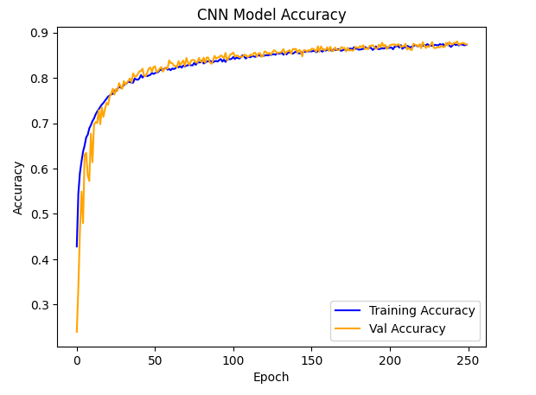
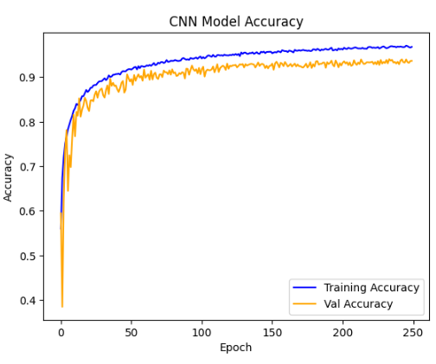
Current Model Performance
Accuracy Graph for Model with 12 Gestures:
Overall Performance
Model with 12 gestures:
Validation Accuracy: 87%
Training Accuracy: 90%
Model with 8 gestures:
Removed Gestures 2, 9, 10, 12
Improved Validation Accuracy to 94%
Training Accuracy: 99%
Current Code: https://github.com/JuliaCJ/FlexType-EMG-Keyboard/blob/main/Gesture_Recognition_CNN_New.ipynb
Accuracy Graph for Model with 8 Gestures:

Slide 7
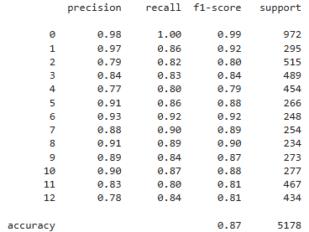
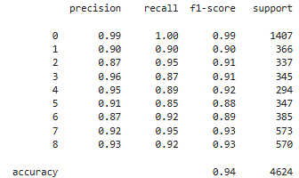
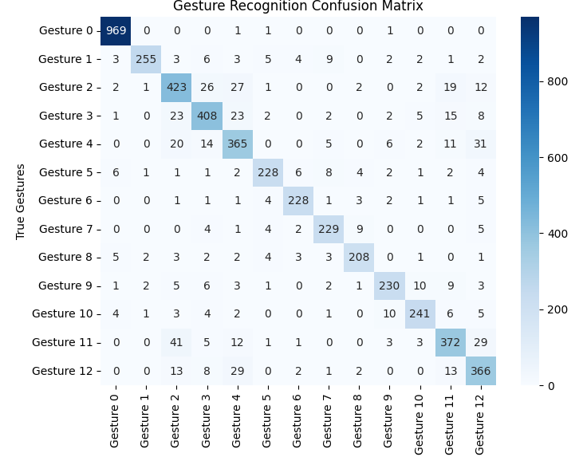
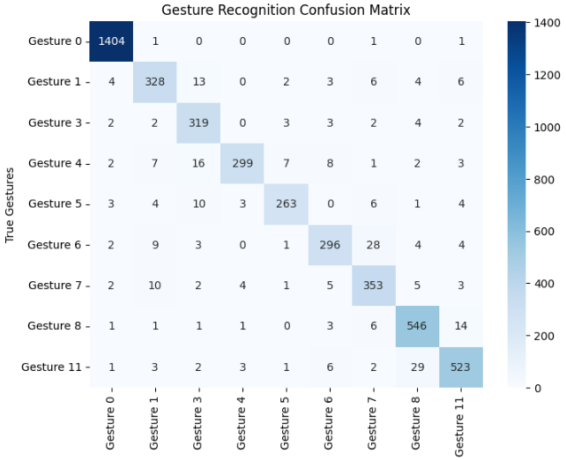
Current Model Performance
Individual Gesture Performance
12 Gesture Model
4 Gestures above 90%
Most Gestures had low 80% accuracy
8 Gesture Model
6 Gestures above 90%
Lowest accuracy is 88% for individual gesture

Slide 8
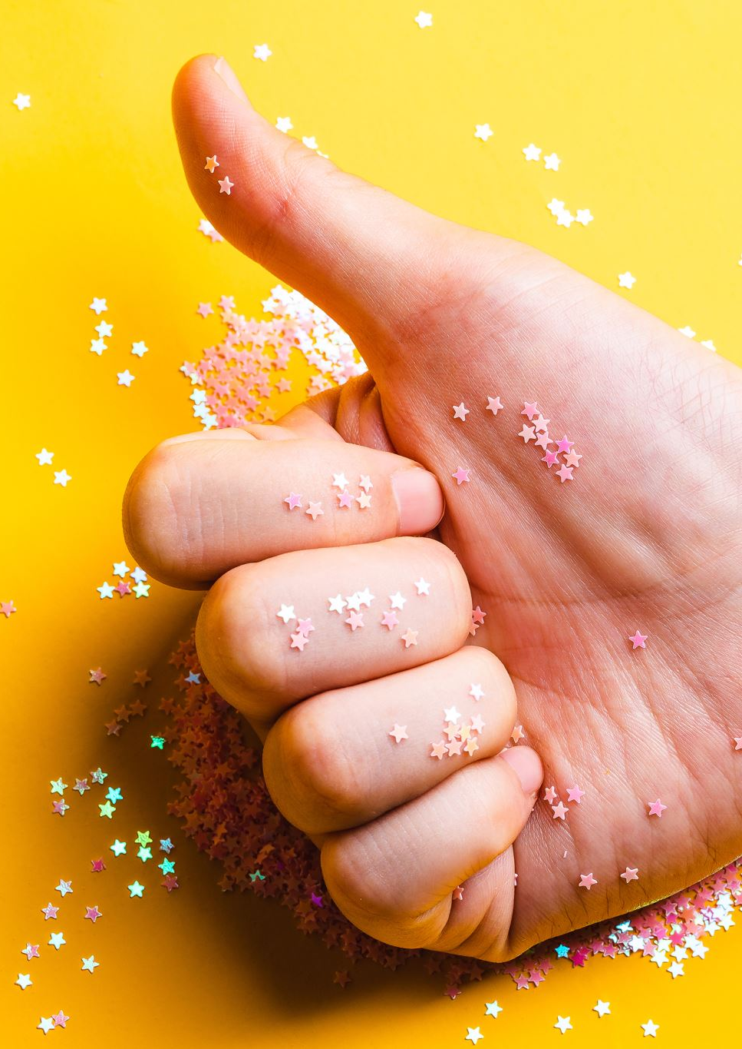
Best Gestures
Two-Finger Wave - "Swipe"
Middle Pinch - [A-F]
Ring Pinch - [G-M]
Pinky Pinch - [N-T]
L-Sign - [U-Z]
Thumb-Out - "Delete"
Knock - "Space/ Enter"
Wiggle Fingers - "Start/ Stop"

Slide 9
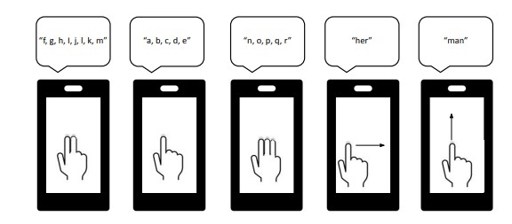
Existing FlexType Model
The FlexType Model is a word prediction model created by Dr. Dylan Gaines
The model assigns letter groups to gestures, then uses a n-gram language model to predict what word is being typed
The current model was designed for a touch screen, and used 4 different gestures
We will alter how it takes an input to assign 8 different gestures to various letter groups and controls
Non-letter controls will be 'start/stop', 'space/ enter', 'delete', and 'swipe'

Slide 10
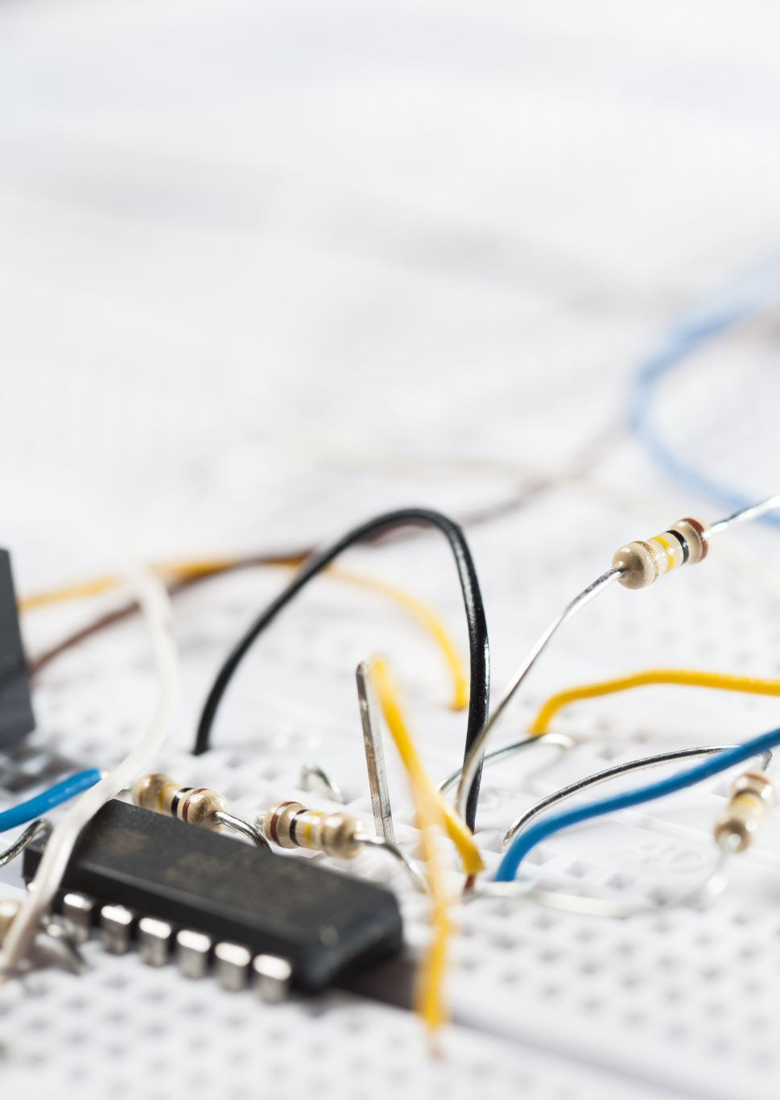
PCB Design Milestone
Goal:
Components for each PCB was ordered
A lot of the component's shipment got delayed, so reordered them to be safe
Started soldering the components that we do have
Once the remaining components arrive will finish assembling the PCBs and start the software/hardware integration

Slide 11
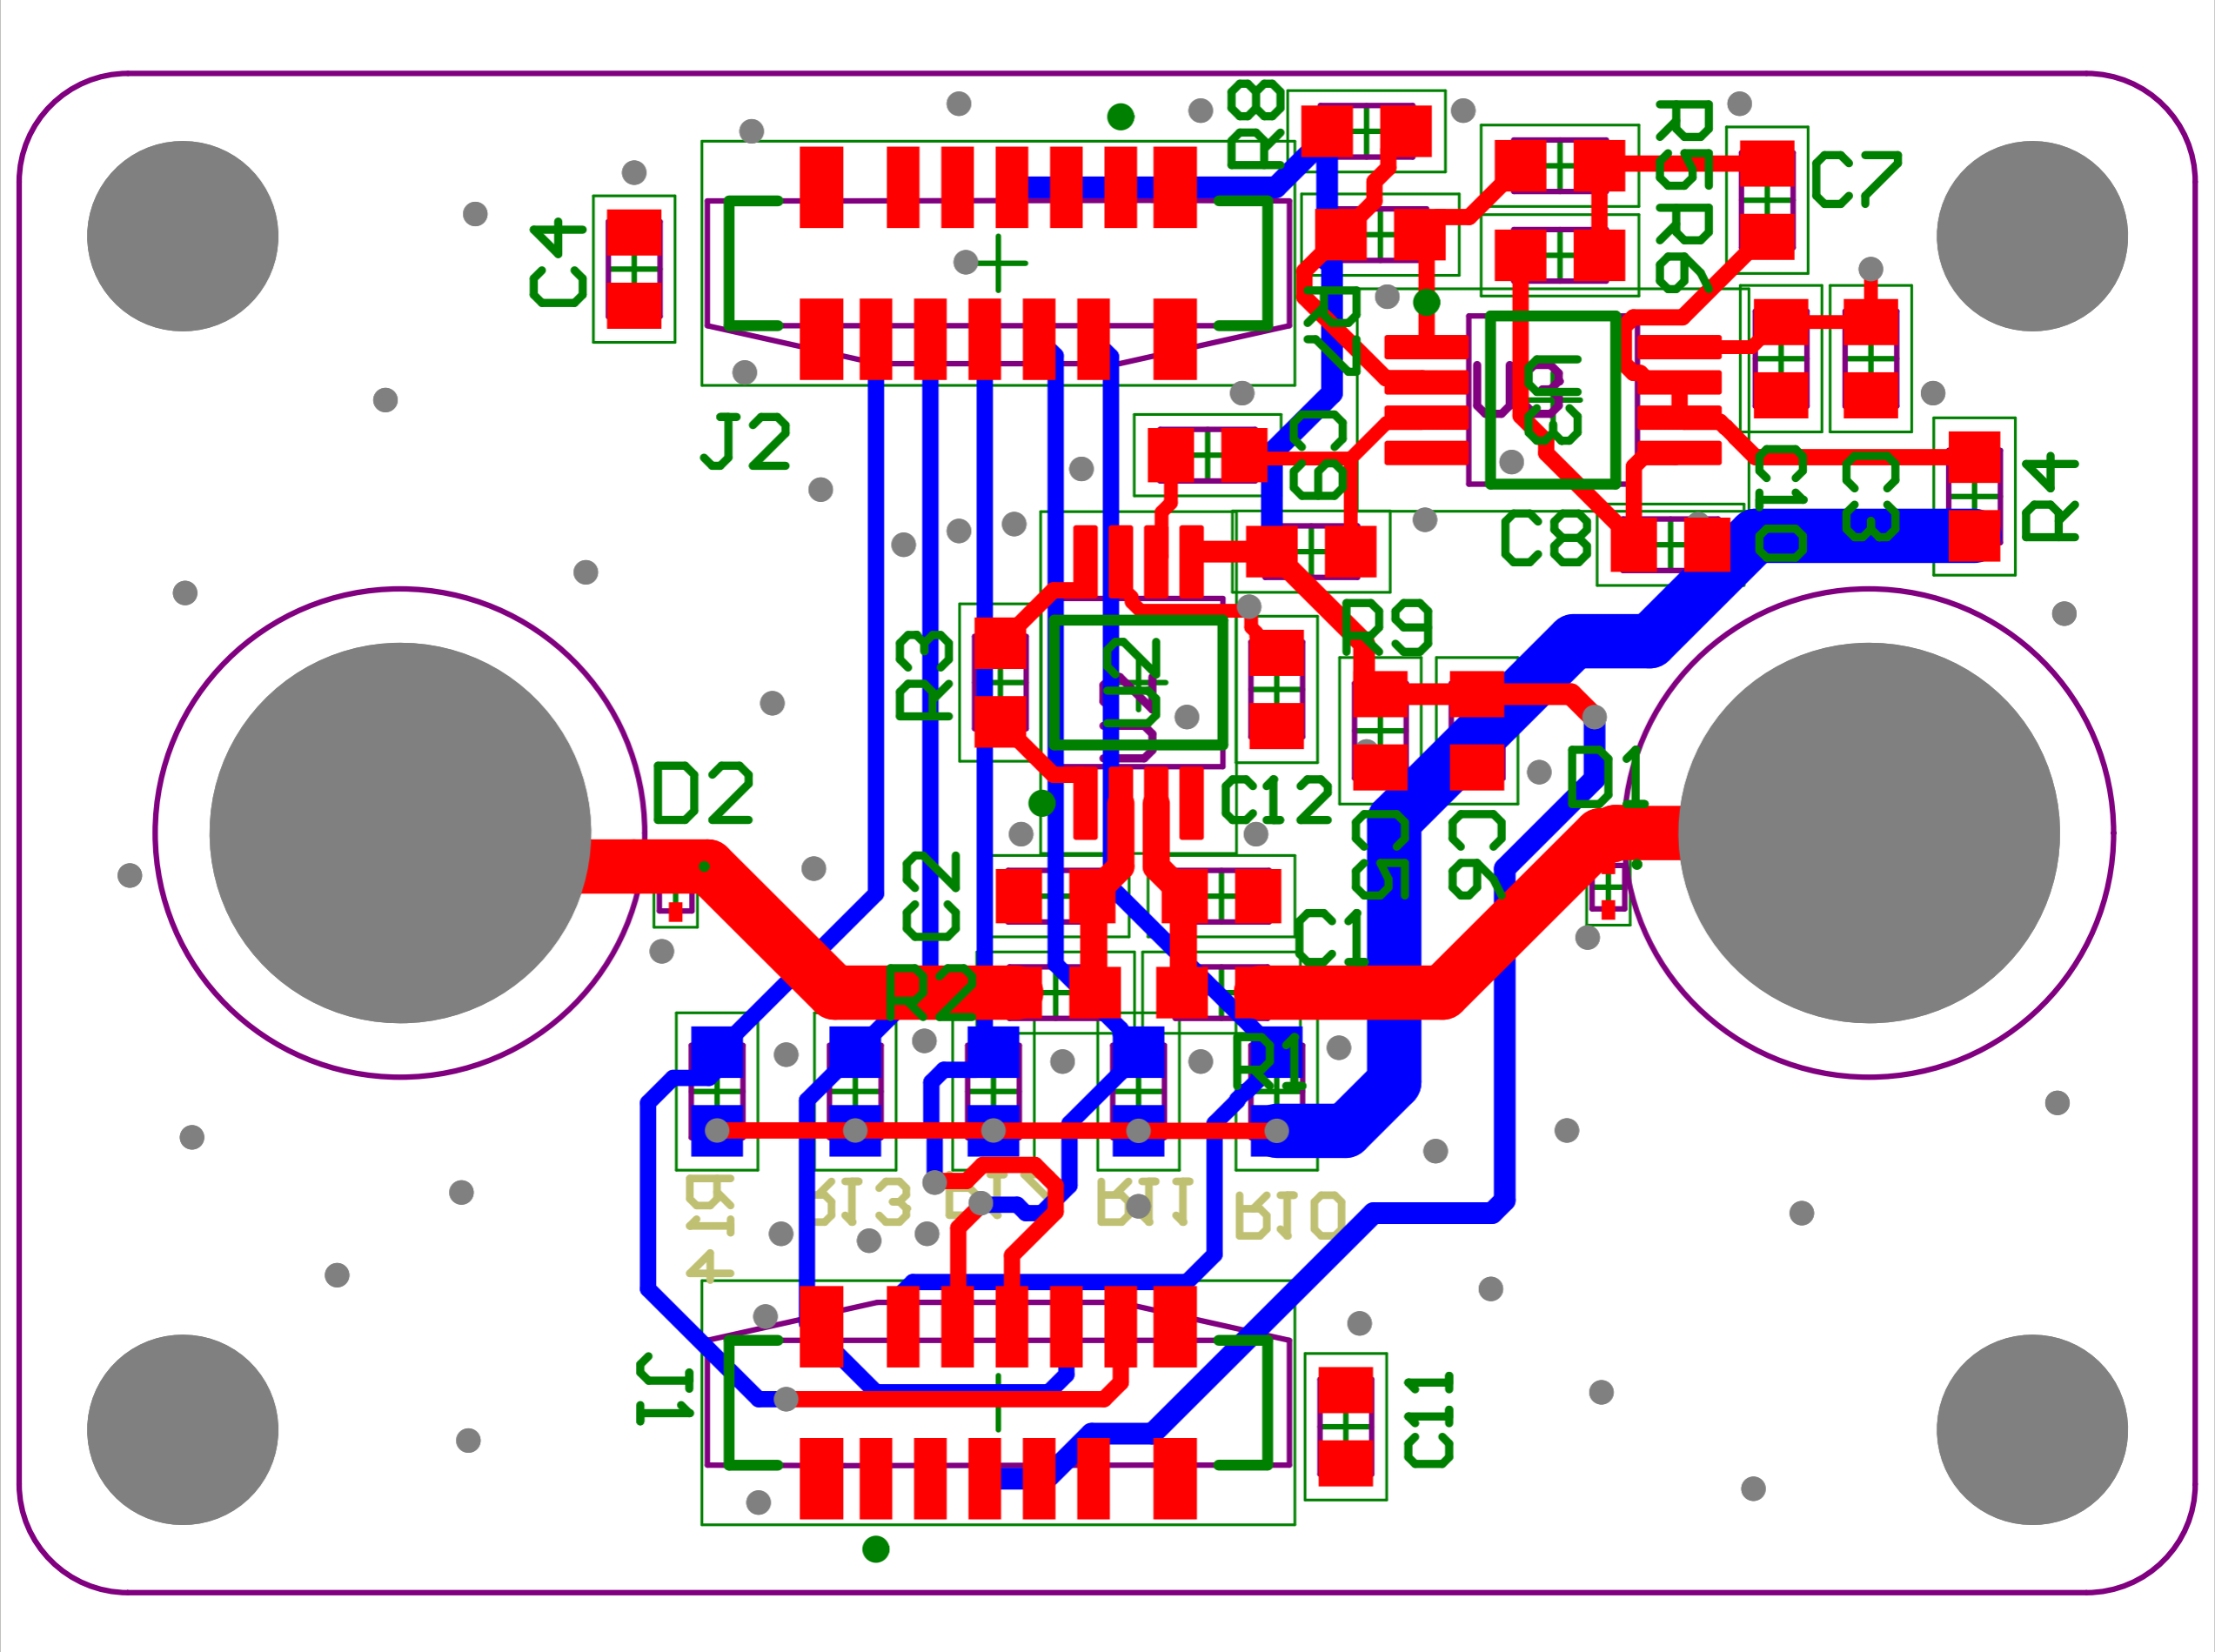
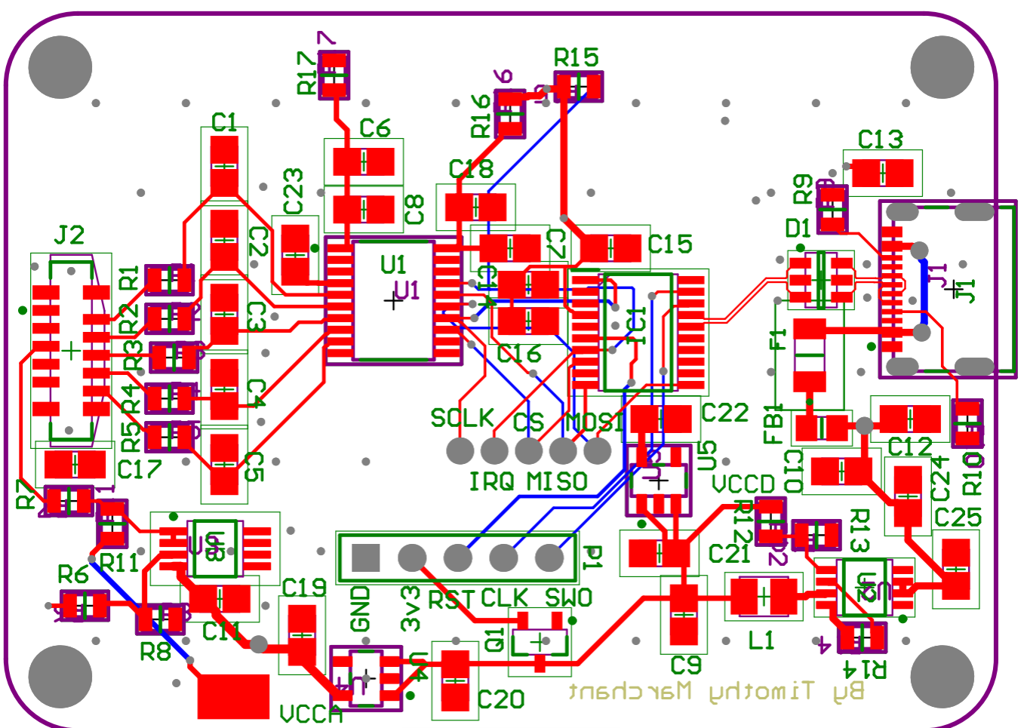
PCB Designs
Electrode Board
Control Board

Slide 12
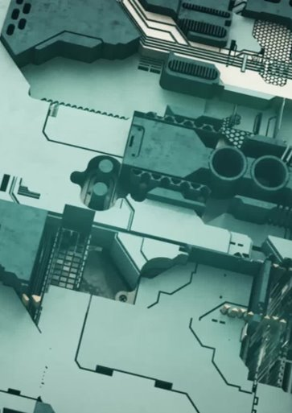
Case Design Milestone
Goal:
Completed the new versions of each enclosure
Both enclosures are now roughly 43% smaller than version 1
Instead of the ears for attaching our wristband being on the sides of the case. They are now on top of the lid, so the footprint of the case is smaller.

Slide 13
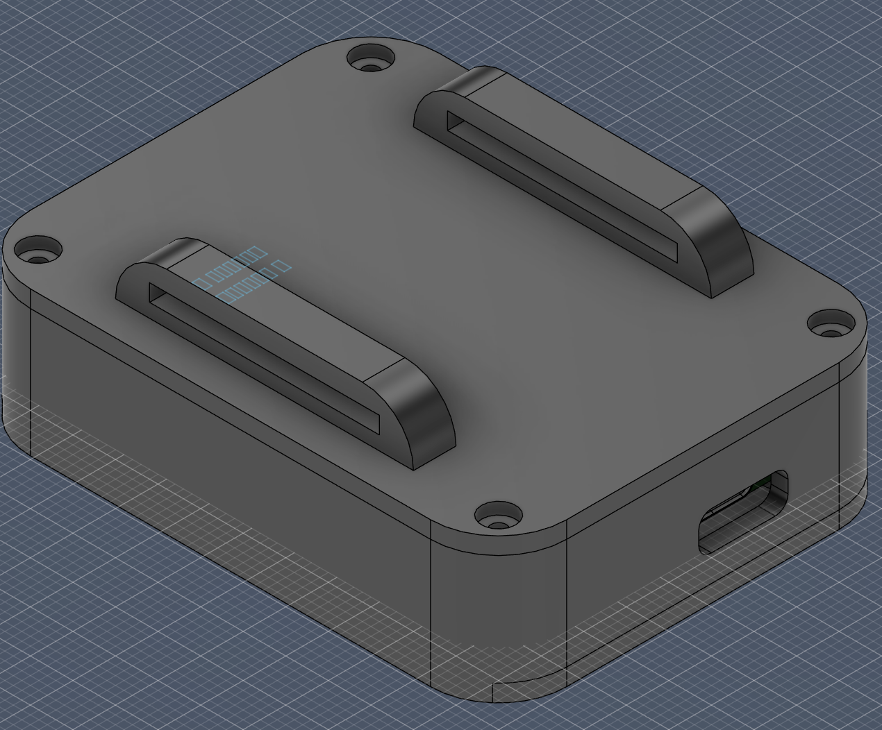
Case Design Control Board PCB

Slide 14
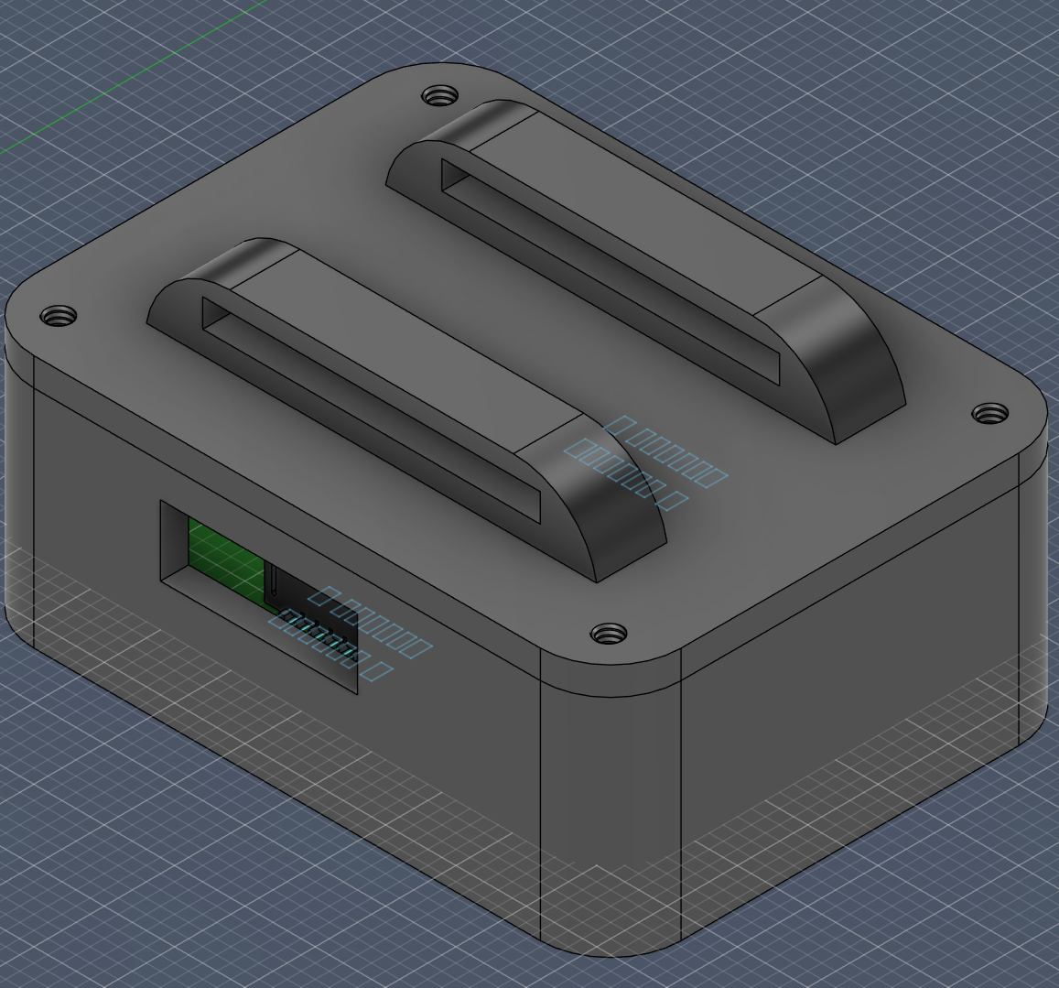
Case Design Electrode Board PCB

Slide 15

Accomplishments
SoftWare
HardWare
Succeeded at getting overall gesture prediction model above 90% accuracy
Was able to take in new data from 9 people
Most gestures performing above 90% accuracy with prediction model
Assigned final gestures to their letter groups/ commands
Ordered all the components for the PCBs
Made each enclosure roughly 43% smaller than earlier version
Fit tested each enclosure with their respected PCBs
Started soldering the components we have on to the PCBs

Slide 16

Challenges and Obstacles
SoftWare
HardWare
Still not able to get many volunteers
Two gestures still under 90% accuracy
Unable to run the FlexType model locally on Raspberry Pi
Designing the electrode PCB enclosure to be small enough so that 3 to 4 PCBs can fit on an arm.
Made the footprint of the case as tight as possible and then started building upwards. To fit things like the ears and mounting holes
First time soldering with such small and compact components took a lot of patience.

Slide 17
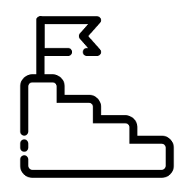
Next Steps
Software
Hardware
Reduce Required Volunteers
Because model is above to 90% accuracy, we can reduce the number of needed volunteers
Begin Working with Raspberry Pi
Migrate Gesture Model to Raspberry Pi
Integrate Gesture Model with FlexType Model
Create main driver/ code for live data recording and interpretation
Take in live EMG data
Send to gesture recognition model
Submit gestures to word prediction model
Output predicted text
Combine PCB with Remaining Components
Once the remaining components arrive, we will finish assembling the PCBs
Connect PCB with Raspberry Pi for Live Data Gathering
Start testing the functionality of the PCB so it is ready for software integration
Word Prediction Model on Raspberry Pi
Raspberry Pi will have to access the word model via Dylan's server and not locally

Slide 18

Questions

